Slide 1
String and Number datatype

Slide 2

01
STRING
Represent text

Slide 3
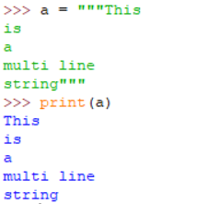
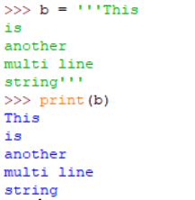
String represent any type of text, symbols, numbers
String is defined by using a pair of single quotes, or double quotes
But…. why???
"This is a string"
'This is also a string'
String can span multiple lines by using three double quote, or three single quotes

Slide 4

String concatenation
Python string allows the use of the “+” operator to concat 2 strings together

Slide 5

String interpolation
String can contain variable placeholder, or an expression
To use it, just prefix the string with ‘f’ character, and put the variable/expression in a pair of curly brackets ‘{ }’

Slide 6
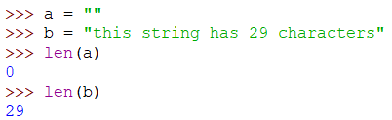
String length
To get the length of a string, pass the string to the len() function

Slide 7
Substring, get character at position
Characters in string start at 0, end at len() - 1
Substring: get part of the string, using the syntax str[start_position:end_position]
Where end_position is exclusive
Get a character at a position: str[position]

Slide 8


Substring, get character at position
message[10]
H | e | l | l | o |  | w | o | r | l | d | !
H | e | l | l | o |  | w | o | r | l | d | !
message
H | e | l | l | o |  | w | o | r | l | d | !
0 | 1 | 2 | 3 | 4 | 5 | 6 | 7 | 8 | 9 | 10 | 11
message[2:8]

Slide 9
Strings are immutable!!!
You’re not allowed to change a character inside a string just by assigning it to a new character!!

Slide 10
02
Number types
Simply remember: there are only Int and Float

Slide 11
int
float
type()
Integer denotes whole number
number_of_students = 20
late_students = 0
score = -2
Floating point represents decimal number. It’s defined by the “symbol .”
speed = 2033
height = -6..0
weight = 12.
Score = .5

Slide 12
03
Mathematical operators
+ - * / % **

Slide 13
Any variable of type int or float can perform mathematical operation with each other
The result produced from the operation depends on the larger type
Int with int => int
Float with float => float
Int with float => float

Slide 14








Common operations
Addition
Subtraction
Multiplication
Division

Slide 15


Other operations
Modulus
Exponential
The remainder is 1
10 ^ 3 = 10 * 10 * 10 = 1000

Slide 16
Associativity
10 - 6 - 1 = 5 or 3

Slide 17
Associativity
The associativity of an operator tells you what to do when you have a run of multiple instance of the same operator
left associative operator: +, -, *, /
right associative operator: **

Slide 18
Precedence
20 : 5 * 2 = 2 or 8

Slide 19
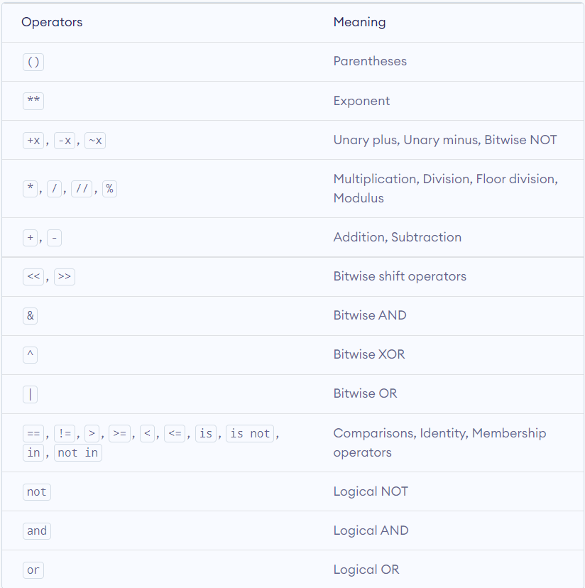
Precedence
The precedence of an operator tells you what to do when you have a mix of different operator
Notes: Sometimes you need to import Math library to use more functions
The operator precedence in Python (in descending order)

Slide 20


Slide 21
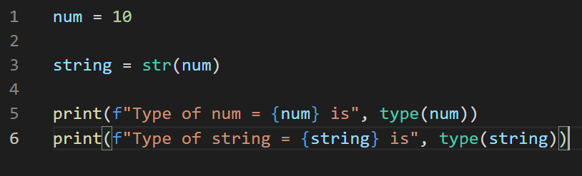

Casting between data types
You can cast to specify a type on to a variable
int() -> Construct an integer number
float() -> Constructs a float number
str() -> Constructs a string

Slide 22
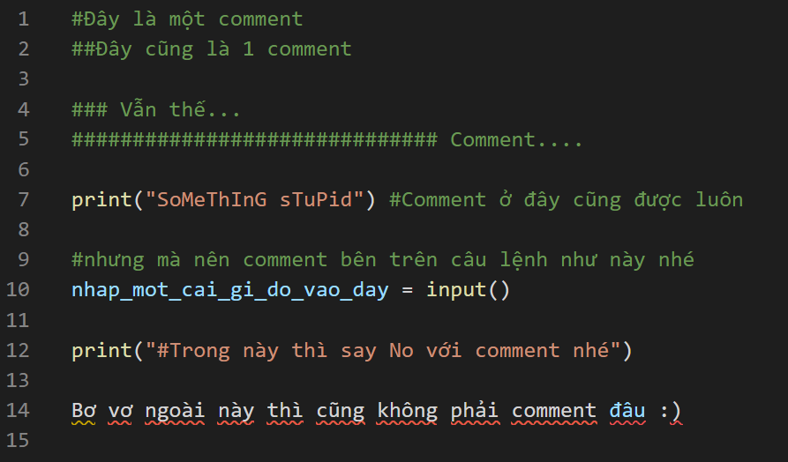
Comment in Python
Commenting

Slide 23
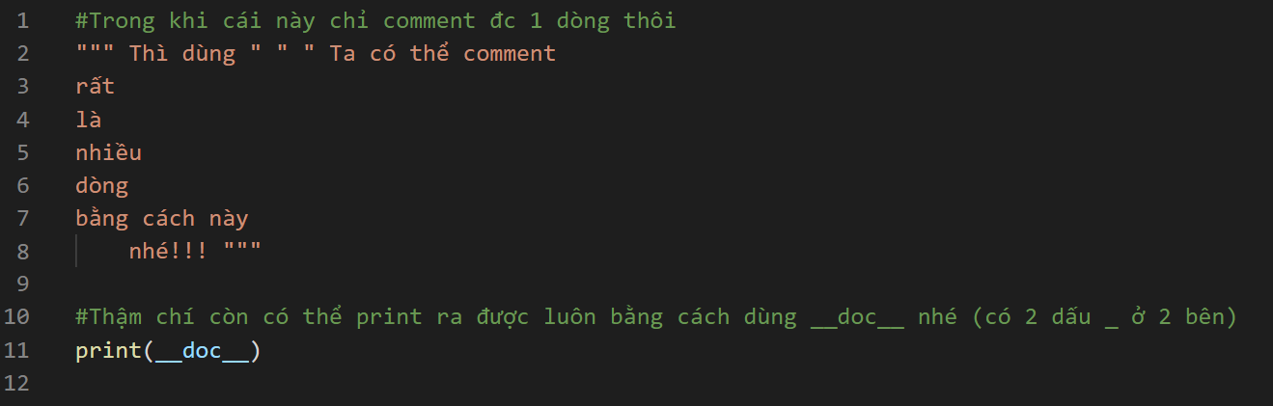
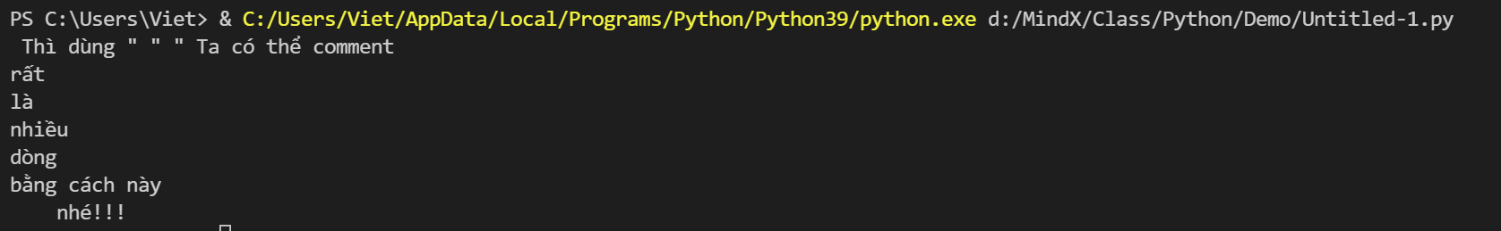
Docstring in Python
Commenting

Slide 24
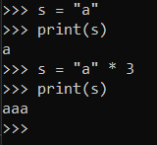
Multiply a string
STRING
A string can be multiplied by a number to get a new string

Slide 25
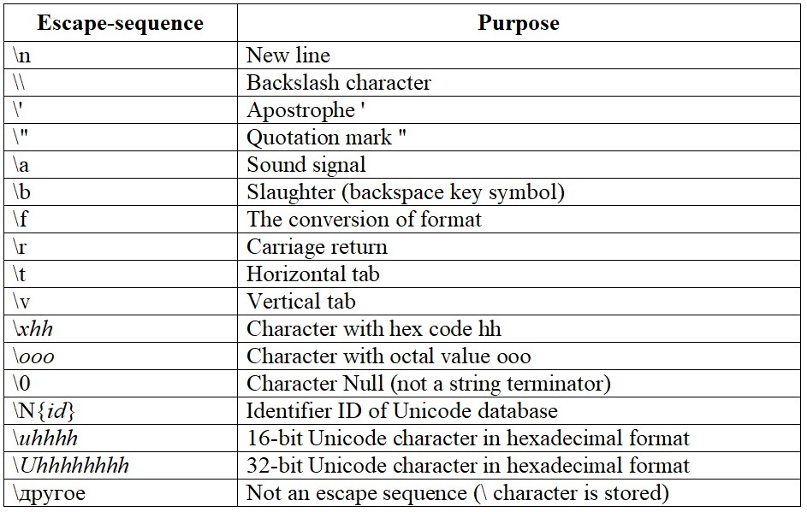
STRING
Escape Sequence
To include special characters in strings
=> by adding a backslash before the character.

Slide 26
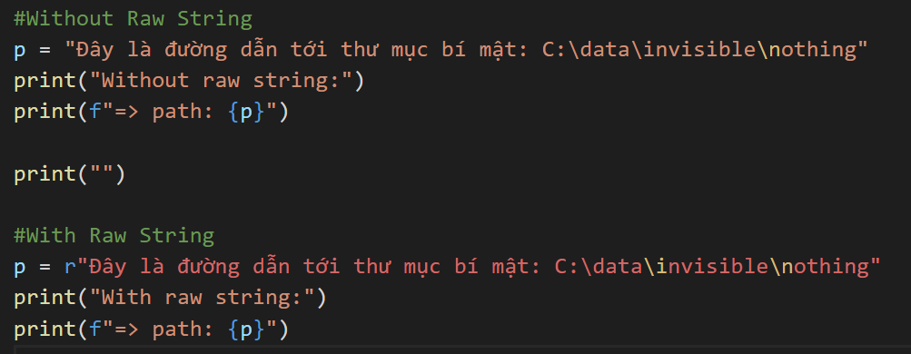
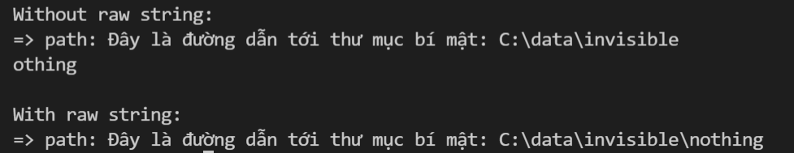
STRING
Raw String
To ignore the escape sequence
=> By prefixing the string with ‘r’ or ‘R’

Slide 27
STRING
Substring, get character at position
Slice with negative indices
message[-2]
H | e | l | l | o |  | w | o | r | l | d | !
H | e | l | l | o |  | w | o | r | l | d | !
message
H | e | l | l | o |  | w | o | r | l | d | !
-12 | -11 | -10 | -9 | -8 | -7 | -6 | -5 | -4 | -3 | -2 | -1
message[-10:-4]

Slide 28
STRING
Substring, get character at position
What would happen if step is a negative number ?
syntax: str[start_position:end_position:step]
H | e | l | l | o |  | w | o | r | l | d | !
message
H | e | l | l | o |  | w | o | r | l | d | !
0 | 1 | 2 | 3 | 4 | 5 | 6 | 7 | 8 | 9 | 10 | 11
message[3:11:2]

Slide 29
String format() method
STRING
A string can be multiplied by a number to get a new string
syntax: “string {} ”.format(value1, value2, value3… )
“string” includes the placeholder:
Defined using curly brackets { }
Identified using named indexes {name} by user ; numbered indexes {0}, {1}… counts from 0 ; or empty {}
Values (of any data type) to be inserted in the string

Slide 30
String format() method
STRING
The Placeholders:
fact = "I am very hungry. I need to {} {} and {} {}.".format()
fact = "I am very hungry. I need to {} {} and {} {}."
1. Named indexes: (by user
2. Numbered indexes: (values inside format() are counted from 0, in this example, we have 4 values are in order: 0,1,2,3)
3. Empty placeholders: (placeholders are assigned values from left to right)
=> They have the same OUTPUT:

Slide 31
String format() method
STRING
You can also add a formatting type to format the result
=> Try it now: Python String format() Method (w3schools.com)

Slide 32
String methods
STRING
There are many built-in methods that you can use on strings.
(e.g: Convert all characters to uppercase, remove extra whitespaces…)
=> Try it now: Python String Methods (w3schools.com)

